Slide 1
Welfare Impacts of an Irrigated Rotational Grazing System
Miles Rollison

Slide 2
OUTLINE
BACKGROUND
MOTIVATION
RESEARCH QUESTIONS
METHODOLOGY
EMPIRICAL STRATEGY
DISCUSSION

Slide 3
BACKGROUND
This work is part of a multidisciplinary research collaboration between the Animal Science Department , Crop & Soil Science Department and DARE.
The other departments have developed an irrigated forage system and shown that it is technically feasible.
Our efforts will be to analyze economic and social feasibility
Notes:
Larger multi University

Slide 4
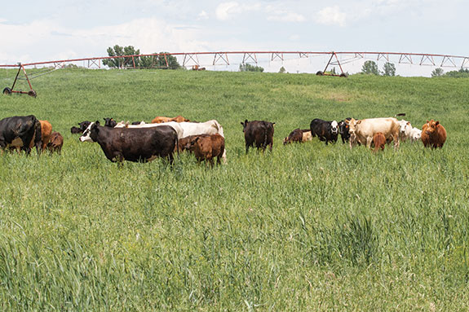

Slide 5
MOTIVATIONS
Groundwater is currently being used in an unsustainable manner
Crops grown under pivot irrigation are high input, high risk commodities
Conventional production of both meat and row crops generate many negative externalities that impact human health, environmental quality, adjacent property values, etc.

Slide 6
Externalities from Agriculture in the Literature
Perkin, Joshuah S., Keith B. Gido, Jeffrey A. Falke, Kurt D. Fausch, Harry Crockett, Eric R. Johnson, and John Sanderson. "Groundwater declines are linked to changes in Great Plains stream fish assemblages." Proceedings of the National Academy of Sciences 114, no. 28 (2017): 7373-7378.
Sneeringer, Stacy. "Does animal feeding operation pollution hurt public health? A national longitudinal study of health externalities identified by geographic shifts in livestock production." American Journal of Agricultural Economics 91, no. 1 (2009): 124-137.
Ready, Richard C., and Charles W. Abdalla. "The amenity and disamenity impacts of agriculture: estimates from a hedonic pricing model." American Journal of Agricultural Economics87, no. 2 (2005): 314-326.

Slide 7
Rough Estimates for Differences in Profitability
594,000 gallons of water / per acre corn with estimated yield 200 bu @ $3.40/bu
$0.42 / 1000 gallons of water
$40,000 / quarter section
190,296 gallons of water / per acre forage with estimated 9 AUM @ $1225 / GF Beef
$3.20 / 1000 gallons of water
$97,920 / quarter-section
Notes:
250 612

Slide 8
RESEARCH QUESTIONS
What are the factors that will influence adoption of this production system by high-plains ranchers?
How many acres are likely to be converted to this system and what are the associated welfare impacts?

Slide 9
METHODOLOGY
Use information from collaborators and from the literature to build a reliable estimate of welfare impacts on an area basis (per 10 acre plot, per quarter section, etc.)
Combine stated preference, revealed preference and market data to estimate risk preferences and likelihood of adoption to estimate continuous choice model.
Use results of continuous choice modeling to estimate aggregate and spatial components of welfare impact (e.g. water quality, riparian habitat, etc.)

Slide 10
EMPIRICAL STRATEGY - ADOPTION
Random Utility Choice Model
U_{C} = 𝛽₀ + 𝛽_{C} X_{C} + 𝜺_{C}
U_{F} = 𝛽_{F} X_{F} + 𝜺_{F}
exp( 𝛽_{F} X_{F} )
Pr_{F} = exp( 𝛽_{F} X_{F} ) + exp(𝛽₀ + 𝛽_{C} X )

Slide 11
Possible Outcomes and Further Research
Identify alternative to traditional production and marketing enterprises for high-plains producers that are both profitable and socially responsible.
Policy implications for appropriating funds to encourage adoption of this system over less socially beneficial practices.
How does increased availability of pasture raised beef affect consumer demand?

Slide 12
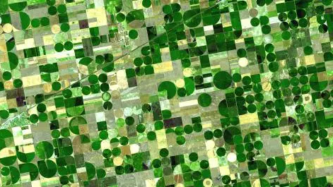
THANK YOU

